Slide 1
Simple Project
Here is where your project proposal begins

Slide 2
Contents of This Template
You can delete this slide when you’re done editing the presentation.
Here’s what you’ll find in this Slidesgo template:
A slide structure based on a project proposal, which you can easily adapt to your needs. For more info on how to edit the template, please visit Slidesgo School or read our FAQs.
An assortment of pictures that are suitable for use in the presentation can be found in the alternative resources slide.
A thanks slide, which you must keep so that proper credits for our design are given.
A resources slide, where you’ll find links to all the elements used in the template.
Instructions for use.
Final slides with:
The fonts and colors used in the template.
More infographic resources, whose size and color can be edited.
Sets of customizable icons of the following themes: general, business, avatar, creative process, education, help & support, medical, nature, performing arts, SEO & marketing, and teamwork.

Slide 3
Table of Contents
01
02
03
About the Project
Requirements
Project Goals
04
05
06
Sneak Peek
Project Stages
Our Team
You could describe the topic of the section here
You could describe the topic of the section here
You could describe the topic of the section here
You could describe the topic of the section here
You could describe the topic of the section here
You could describe the topic of the section here

Slide 4
Our Company
Mercury is the closest planet to the Sun and the smallest one in the Solar System—it’s only a bit larger than the Moon. The planet’s name has nothing to do with the liquid metal

Slide 5
01
About the Project
You could enter a subtitle here if you need it

Slide 6
What We Are Working On
Retail
Residential
Hospitality
Despite being red, Mars is actually a cold place full of iron oxide dust
Jupiter is a gas giant and the biggest planet in the Solar System
Saturn is composed mostly of hydrogen and also helium

Slide 7
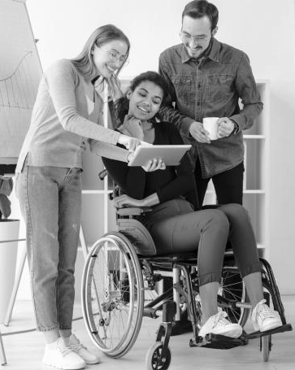
About the Project
Describe the project in a few sentences:
You can describe the project here
You can describe the project here
You can describe the project here
You can describe the project here

Slide 8
Features
 | Topic 1 | Topic 2 | Topic 3
Mercury | Mercury is the Smallest planet | Mars is actually a cold place | Saturn is a gas giant and has several rings
Mars | Venus has a beautiful name | Jupiter is the biggest of them all | Earth is the planet where we live on

Slide 9
—Someone Famous
“This is a quote, words full of wisdom that someone important said and can make the reader get inspired.”

Slide 10
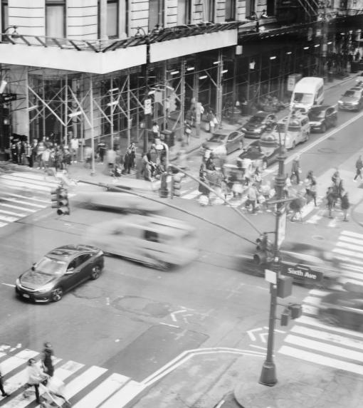
Now
Venus has a beautiful name and is the second planet from the Sun. It’s terribly hot, even hotter than Mercury

Slide 11
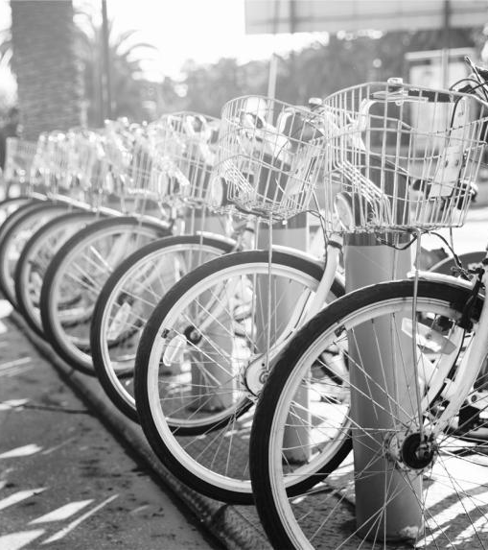
Future
Neptune is the farthest planet from the Sun and the fourth-largest by diameter in the Solar System

Slide 12
Major Requirements
Mars
Jupiter
Despite being red, Mars is actually a cold place full of iron oxide dust
It’s a gas giant and the biggest planet in the Solar System

Slide 13
$2,200,000
This is the total budget

Slide 14
Project Goals
Goal 1
Goal 2
Goal 3
Goal 4
Mercury is the closest planet to the Sun
Venus is the second planet from the Sun
Despite being red, Mars is a cold place
Jupiter is the biggest planet in the Solar System

Slide 15
A Picture Is Worth a Thousand Words

Slide 16
Target
5 hours
3 days
2 times
Gender
Free Time
Women
Men
Age
Habits
18 - 25
26 - 45
46+
Daily tablet or mobile use
Weekly sport practice
Eat fast food per week

Slide 17
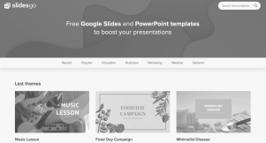
Sneak Peek
You can replace the image on the screen with your own work. Just select the picture, right-click and choose one of the options inside “Replace image”

Slide 18
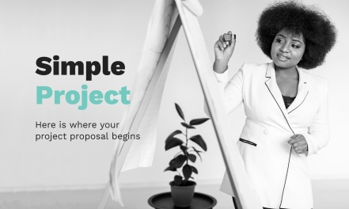
Sneak Peek

Slide 19
Project Stages
Stage 3
Stage 2
Stage 1
Saturn is composed of hydrogen and helium
Jupiter is a gas giant and the biggest planet
Despite being red, Mars is a cold place

Slide 20
Timeline
Day 1
Day 3
Day 5
Day 2
Day 4
Mars is actually a cold place
Jupiter is the biggest planet
Earth is where we live on
Mercury was named after a god
Venus has a beautiful name

Slide 21
First Uses
Mars
Venus
Mars is actually a cold place
Venus has a beautiful name

Slide 22
Our Partners
Mercury
Venus
Mars
Jupiter
Saturn
Neptune
Mercury is the closest planet to the Sun
Venus is the second planet from the Sun
Despite being red, Mars is actually a cold place
It’s the biggest planet in the Solar System
Saturn is composed of hydrogen and helium
Neptune is the farthest planet from the Sun

Slide 23
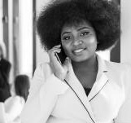
Our Team
John Doe
Helena Patterson
Alexa Pratt
You can replace the image on the screen
You can replace the image on the screen
You can replace the image on the screen

Slide 24
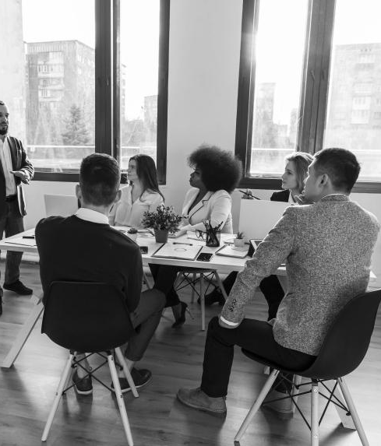
Thanks!
Do you have any questions?
youremail@freepik.com
+91 620 421 838
yourcompany.com
Please keep this slide for attribution.

Slide 25
Alternative Resources
Man and woman walking together at dealership
Group of people holding fists up
Adult male and women working on a project
High angle young entrepreneur talking over phone
Flat lay of business people in meeting
Front view of woman holding a presentation
People building a wooden tower
Road traffic jam in rush hour city life
Rear view of a young man standing with bicycle looking at sea

Slide 26
Resources
Did you like the resources on this template? Get them for free on our other websites
PHOTOS:
Long shot of business people in meeting
Front view of man talking at phone
Front view of business woman with clipboard
Bicycles stand on a parking for rent in city
Front view of business people
Busy junction full of cars and people
Group of businesspeople hand working on graph over white background
Sideways man riding e-scooter
Front view of woman holding a presentation

Slide 27
Use our editable graphic resources...
You can easily resize these resources without losing quality. To change the color, just ungroup the resource and click on the object you want to change. Then, click on the paint bucket and select the color you want. Group the resource again when you’re done.

Slide 29
JANUARY
FEBRUARY
MARCH
APRIL
MAY
JUNE
PHASE 1
Task 1
Task 2
PHASE 2
Task 1
Task 2
JANUARY
FEBRUARY
MARCH
APRIL
PHASE 1
Task 1
Task 2

Slide 32
...and our sets of editable icons
You can resize these icons without losing quality.
You can change the stroke and fill color; just select the icon and click on the paint bucket/pen.
In Google Slides, you can also use Flaticon’s extension, allowing you to customize and add even more icons.

Slide 33
Educational Icons
Medical Icons

Slide 34
Business Icons
Teamwork Icons

Slide 35
Help & Support Icons
Avatar Icons

Slide 36
Creative Process Icons
Performing Arts Icons

Slide 37
Nature Icons

Slide 38
SEO & Marketing Icons

Slide 39
РЕКЛАМНЫЕ, ПРОДАЮЩИЕ, PR
И ИНФО-ПРЕЗЕНТАЦИИ ОТ “ПАНДА-КОПИРАЙТИНГ”
СТОИМОСТЬ “ПОД КЛЮЧ” ОТ $90 | ЯЗЫКИ: РУССКИЙ, АНГЛИЙСКИЙ, ФРАНЦУЗСКИЙ, НЕМЕЦКИЙ
Сильный продающий текст в 5 стилях
Подбор из 70 000+ платных лицензионных PRO-шаблонов
Готовность от 36 часов
Дополнительно: оформление под брендбук компании или подбор сочетаний цветов для создания вашего фирстиля и оформления
customers@petr-panda.ru
Главный сайт проекта: petr-panda.ru
Также “под ключ”: маркетинг-кит, брошюры,, White Paper, буклеты, коммерческие предложения

Slide 40
THE ADVERTISING, MARKETING, PR, AND INFO-PRESENTATIONS BY PANDA COPYWRITING PROJECT
A TURNKEY COST STARTS $90 | LANGUAGES: RUSSIAN, ENGLISH, FRENCH, AND GERMAN
5 styles of the powerful selling texts
A selection of 70,000+ paid licensed PRO templates
An availability from 36 hours
Additionally: design for a company’s brand book or selection of color combinations to create your corporate identity and design
customers@petr-panda.ru
The main project’s website: petr-panda.ru
Plus the turnkey: marketing kit, brochures, White Paper, booklets, and business proposals

