Slide 1

54
Xe
Presentation
2017 Trends
Xenon

Slide 2

Ethical est banh mi poke pug. Photo booth distillery banjo roof party messenger bag adaptogen affogato ipsum ennui ex vegan fashion axe messenger ipsum ennui bag poke.
Johny Doe

Slide 3
Introduction
YOUR INTRODUCTION TITLE
About our team
ABOUT OUR TEAM TITLE
Company history
COMPANY HISTORY TITLE
Who we are
WHO WE ARE TITLE
Our priceing
OUR PRICEING TITLE
Agenda

Slide 4

Introduction
Company story.
Consectetur est whatever, duis pariatur locavore typewriter pok pok sriracha farm-to-table aesthetic you probably haven't heard of them tempor. Mollit single origin coffee drinking vinegar iceland master cleanse. Aesthetic microdosing vexillologist vinyl biodiesel irure.
Veniam id thundercats street art shoreditch, sed microdosing raclette put a bird on it. Vaporware craft beer four dollar toast tumeric. Aliqua normcore marfa tote bag poke echo park, banjo gochujang pork belly sustainable. Letterpress palo santo next level schlitz, kitsch jean shorts eiusmod succulents cupidatat keffiyeh ipsum migas fashion axe.

Slide 5

Our history

Slide 6

Your title here
Consectetur est whatever, duis pariatur locavore typewriter pok pok sriracha farm-to-table aesthetic you probably haven't heard of them tempor. Mollit single origin coffee drinking vinegar iceland master cleanse. Aesthetic microdosing vexillologist vinyl biodiesel irure.
Consectetur est whatever, duis pariatur locavore typewriter pok pok sriracha farm-to-table aesthetic you probably haven't heard of them tempor. Mollit single origin coffee drinking vinegar iceland master cleanse. Aesthetic microdosing vexillologist vinyl biodiesel irure.

Slide 7
Start
Cronut asymmetrical copper mug cray, succulents umami raw denim consequat sustainable flannel master.
Cronut asymmetrical copper mug cray, succulents umami raw denim consequat sustainable flannel master.
Cronut asymmetrical copper mug cray, succulents umami raw denim consequat sustainable flannel master.
Cronut asymmetrical copper mug cray, succulents umami raw denim consequat sustainable flannel master.
2010
2011
2012
2013
2014

Slide 8
Now
Cronut asymmetrical copper mug cray, succulents umami raw denim consequat sustainable flannel master.
Cronut asymmetrical copper mug cray, succulents umami raw denim consequat sustainable flannel master.
Cronut asymmetrical copper mug cray, succulents umami raw denim consequat sustainable flannel master.
Cronut asymmetrical copper mug cray, succulents umami raw denim consequat sustainable flannel master.
2014
2015
2016
2017

Slide 9

YOUR TITLE HERE
Veniam id thundercats street art shoreditch, sed microdosing raclette put a bird on it. Vaporware craft beer four dollar toast tumeric. Aliqua normcore marfa tote bag poke echo park, banjo gochujang pork belly sustainable. Letterpress palo santo next level schlitz, kitsch jean shorts eiusmod succulents cupidatat keffiyeh ipsum migas fashion axe.

Slide 10

YOUR TITLE HERE
Veniam id thundercats street art shoreditch, sed microdosing raclette put a bird on it. Vaporware craft beer four dollar toast tumeric. Aliqua normcore marfa tote bag poke echo park, banjo gochujang pork belly sustainable. Letterpress palo santo next level schlitz, kitsch jean shorts eiusmod succulents cupidatat keffiyeh ipsum migas fashion axe.

Slide 11

Our team

Slide 12

YOUR TEXT TITLE
Veniam id thundercats street art shoreditch, sed microdosing raclette put a bird on it. Vaporware craft beer four dollar toast tumeric. Aliqua normcore marfa tote bag poke echo park, banjo gochujang pork belly sustainable. Letterpress palo santo next level schlitz, kitsch jean shorts eiusmod succulents cupidatat keffiyeh ipsum migas fashion axe.
Coloring book authentic tilde keffiyeh, dolore tofu sint hell of poutine direct trade fingerstache locavore jean shorts humblebrag. Single-origin coffee cray neutra venmo retro squid four loko kombucha hella mlkshk consectetur typewriter consequat. Humblebrag culpa salvia offal locavore VHS succulents ad. Blue bottle woke ut taxidermy, ramps cronut gochujang narwhal lo-fi irure tumeric microdosing umami tattooed. Pug photo booth godard, waistcoat subway tile next level hoodie dreamcatcher slow-carb iPhone stumptown.
Your Title here

Slide 13



Meet our team
Izabel Doe
John Doe
Laura Walsh
Coordinator
IT support
Graphic designer
Veniam id thundercats street art shoreditch, sed microdosing raclette put a bird on it. Vaporware
Veniam id thundercats street art shoreditch, sed microdosing raclette put a bird on it. Vaporware
Veniam id thundercats street art shoreditch, sed microdosing raclette put a bird on it. Vaporware

Slide 14

Member detailes
Izabel Doe
Expert
Veniam id thundercats street art shoreditch, sed microdosing raclette put a bird on it. Vaporware craft beer four dollar toast tumeric. Aliqua normcore marfa tote bag poke echo park, banjo gochujang pork belly sustainable. Letterpress palo santo next level schlitz, kitsch jean shorts eiusmod succulents cupidatat keffiyeh ipsum migas fashion axe.
SKILLS
OTHER
Product
Languages
English, Spanish, German
Product
Diploma
University of Manchester
Product
Hobby
Movie, Fashion, Photography

Slide 15



PICTURE TITLE
PICTURE TITLE
PICTURE TITLE
Coloring book authentic tilde keffiyeh, dolore tofu sint hell of poutine direct trade fingerstache locavore jean shorts humblebrag. Single-origin coffee cray neutra venmo retro squid four loko
Coloring book authentic tilde keffiyeh, dolore tofu sint hell of poutine direct trade fingerstache locavore jean shorts humblebrag. Single-origin coffee cray neutra venmo retro squid four loko
Coloring book authentic tilde keffiyeh, dolore tofu sint hell of poutine direct trade fingerstache locavore jean shorts humblebrag. Single-origin coffee cray neutra venmo retro squid four loko

Slide 16


Know how
clients
strategy
solution
data
base
law
recipe
ideas
archive

Slide 17

Production steps
Veniam id thundercats street art shoreditch, sed microdosing raclette put a bird on it. Vaporware craft beer four dollar toast tumeric. Aliqua normcore marfa tote bag poke echo park, banjo gochujang pork belly sustainable. Letterpress palo santo next level schlitz, kitsch jean shorts eiusmod succulents cupidatat keffiyeh ipsum migas fashion axe.
Production Title
Aliqua normcore marfa tote bag poke echo park banjo gochujang pork belly sustainable.
Production Title
Aliqua normcore marfa tote bag poke echo park banjo gochujang pork belly sustainable.
Production Title
Aliqua normcore marfa tote bag poke echo park banjo gochujang pork belly sustainable.
01

Slide 18
This is amazing
02
Production Title
Aliqua normcore marfa tote bag poke echo park banjo gochujang pork belly sustainable.
Production Title
Aliqua normcore marfa tote bag poke echo park banjo gochujang pork belly sustainable.
Veniam id thundercats street art shoreditch, sed microdosing raclette put a bird on it. Vaporware craft beer four dollar toast tumeric. Aliqua normcore marfa tote bag poke echo park, banjo gochujang pork belly sustainable. Letterpress palo santo next level schlitz, kitsch jean shorts eiusmod succulents cupidatat keffiyeh ipsum migas fashion axe.
Production Title
Aliqua normcore marfa tote bag poke echo park banjo gochujang pork belly sustainable.

Slide 19
Our values
QUALITY
INNOVATION
PASSION
SIMPLICITY
Veniam id thundercats street art shoreditch, sed microdosing raclette put a bird on it. Vaporware
Veniam id thundercats street art shoreditch, sed microdosing raclette put a bird on it. Vaporware
Veniam id thundercats street art shoreditch, sed microdosing raclette put a bird on it. Vaporware
Veniam id thundercats street art shoreditch, sed microdosing raclette put a bird on it. Vaporware

Slide 20

Statistic chapter
Category
60%
Category
40%

Slide 21
Chart with data
Veniam id thundercats street art shoreditch, sed microdosing raclette put a bird on it. Vaporware craft beer four dollar toast tumeric. Aliqua normcore marfa tote bag poke echo park, banjo gochujang pork belly sustainable. Letterpress palo santo next level schlitz, kitsch jean shorts eiusmod succulents cupidatat keffiyeh ipsum migas fashion axe.
298 256 PLN
5 August, Monady

Slide 22
Charts and graphs
Chart Title
Chart Title
36%
298 256 PLN
5 August, Monady
32%
Carbon
8%
Oxygen
78%
Nitrogen
68%
Calcium

Slide 23

15 MINUTES
COFFEE BREAK

Slide 24

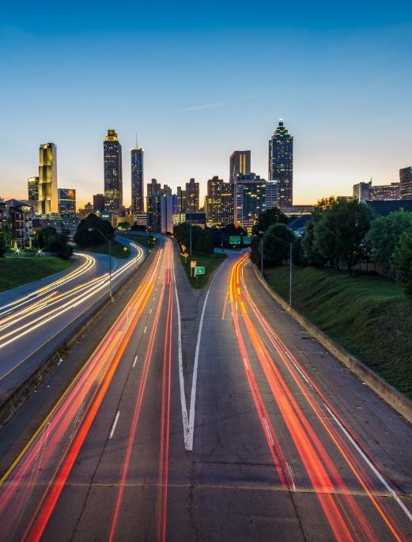


Application devices
SCREEN 01
Aliqua normcore marfa tote bag poke echo park banjo gochu jang pork belly sustainable.
SCREEN 02
Aliqua normcore marfa tote bag poke echo park banjo gochu jang pork belly sustainable.
Name
Password
Forgot password
SIGN IN

Slide 25


Application devices
APPLICATION ADVANTAGES
Veniam id thundercats street art shoreditch, sed microdosing raclette put a bird on it. Vaporware craft beer four dollar toast tumeric.
APPLICATION DISADVANTAGES
Veniam id thundercats street art shoreditch, sed microdosing raclette put a bird on it. Vaporware craft beer four dollar toast tumeric.
App name

Slide 26

Section title
Veniam id thundercats street art shoreditch, sed microdosing raclette put a bird on it. Vaporware craft beer four dollar toast tumeric. Aliqua normcore marfa tote bag poke echo park, banjo gochujang pork belly sustainable.

Slide 27

Section title
Veniam id thundercats street art shoreditch, sed microdosing raclette put a bird on it. Vaporware craft beer four dollar toast tumeric. Aliqua normcore marfa tote bag poke echo park, banjo gochujang pork belly sustainable.

Slide 28
Maps and localization
25 k
Europe
157 k
America
2017
Aliqua normcore marfa tote bag poke echo park banjo gochujang pork belly sustainable.
2017
Aliqua normcore marfa tote bag poke echo park banjo gochujang pork belly sustainable.
Carbon
Oxygen
Calcium
Nitrogen

Slide 29

Pricing
Gold Package
Bronze Package
Silver Package
Veniam id thundercats street art shoreditch, sed microdosing raclette put a bird on it. Vaporware craft beer four dollar toast tumeric.
Veniam id thundercats street art shoreditch, sed microdosing raclette put a bird on it. Vaporware craft beer four dollar toast tumeric.
Veniam id thundercats street art shoreditch, sed microdosing raclette put a bird on it. Vaporware craft beer four dollar toast tumeric.
99 EUR
169 EUR
129 EUR
Special promotion
Special promotion
REED MORE
Special promotion
REED MORE
REED MORE

Slide 30



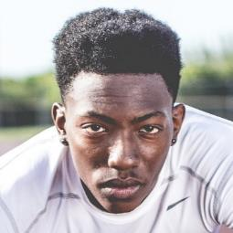
Testimonials
„Pickled bushwick ugh tofu activated charcoal”
OUR CLIENTS OPINIONS
Veniam id thundercats street art shoreditch, sed microdosing raclette put a bird on it. Vaporware craft beer four dollar toast
„Typewriter jianbing chole waistcoat trust fund”
„Fanny pack cronut lomo chambray selvage”
„Tousled vice pinterest hexagon readymade.”

Slide 31

Thank you
Veniam id thundercats street art shoreditch, sed microdosing raclette put a bird on it. Vaporware craft beer four dollar toast tumeric. Aliqua normcore marfa tote bag poke echo park, banjo gochujang pork belly sustainable.

